Slide 1
ALGEBRA
MTS101 / MODULE 3
DR RAJI, M. T

Slide 2
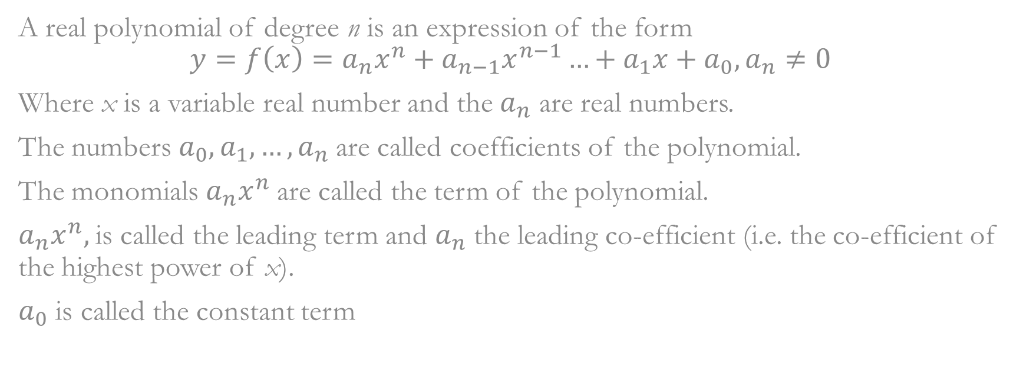
POLYNOMIAL

Slide 3
Polynomial (cont’d)
Polynomial | Degree | Name
 | 0 | Constant
 | 1 | Linear
 | 2 | Quadratic
 | 3 | Cubic
Equality of Polynomials
Two polynomials are equal if they have the same degree and all the corresponding co-efficient are equal.
Addition, Subtraction and Multiplication of Polynomials
Define addition and subtraction of polynomials: as addition and subtraction of corresponding or like terms. Use distributive law of multiplication of numbers over addition to define multiplication of polynomials.

Slide 4
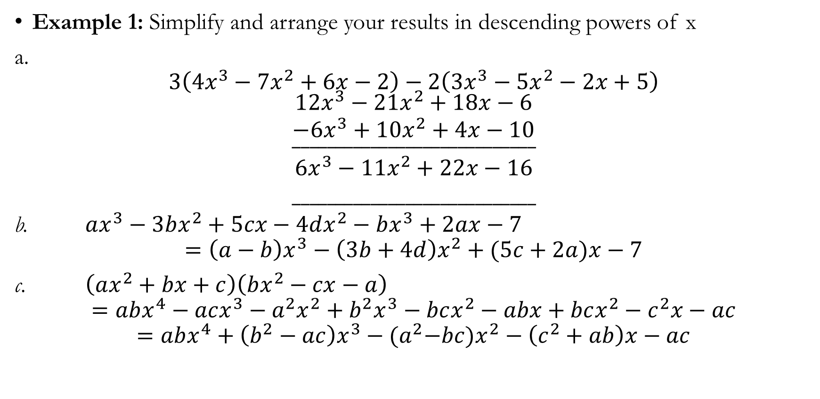
Polynomial (cont’d)

Slide 5
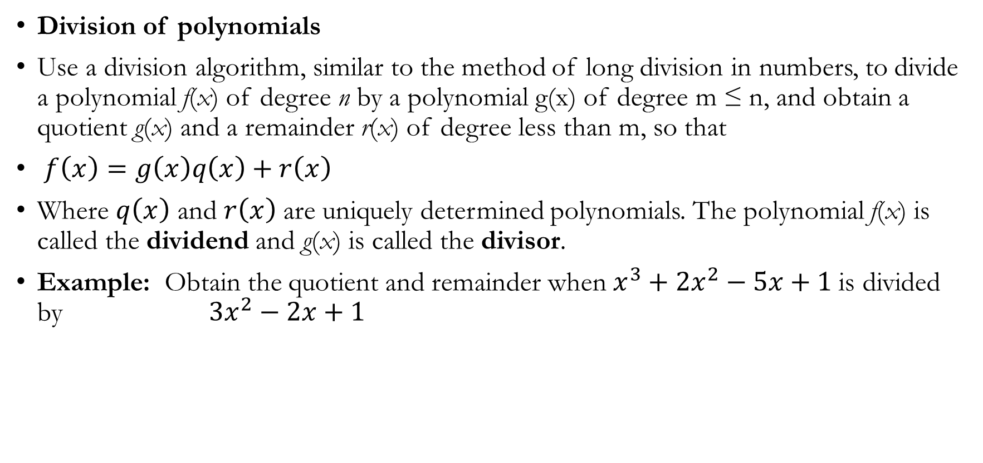
Polynomial (cont’d)

Slide 6
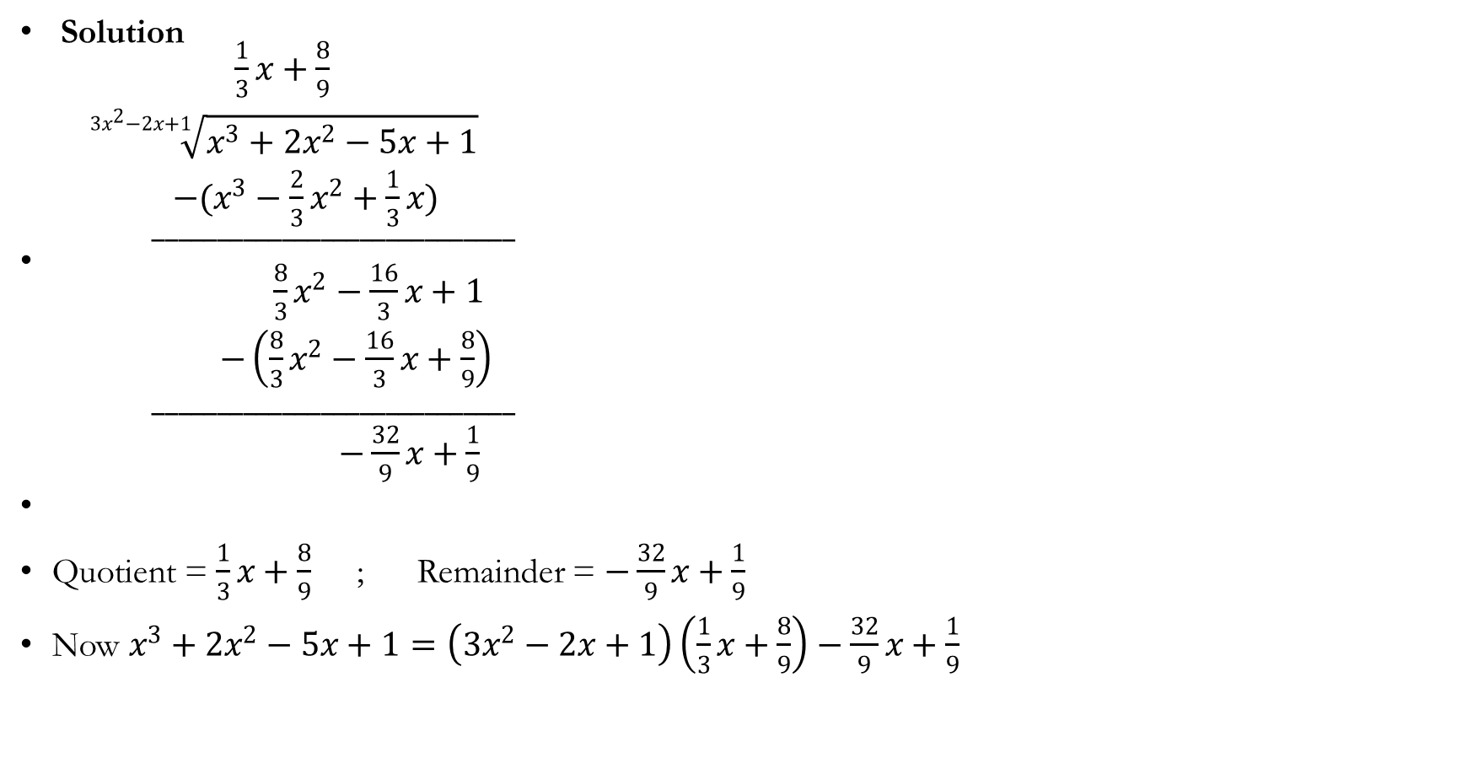

Slide 7
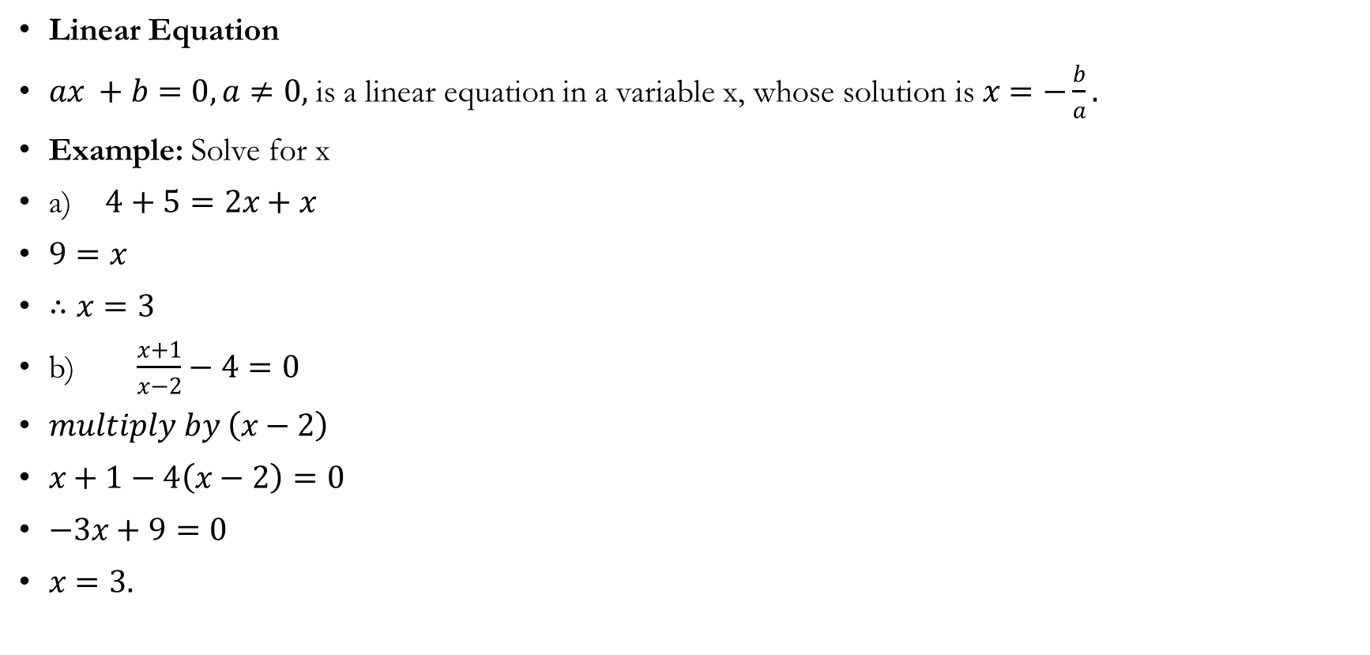
Polynomial (cont’d)

Slide 8
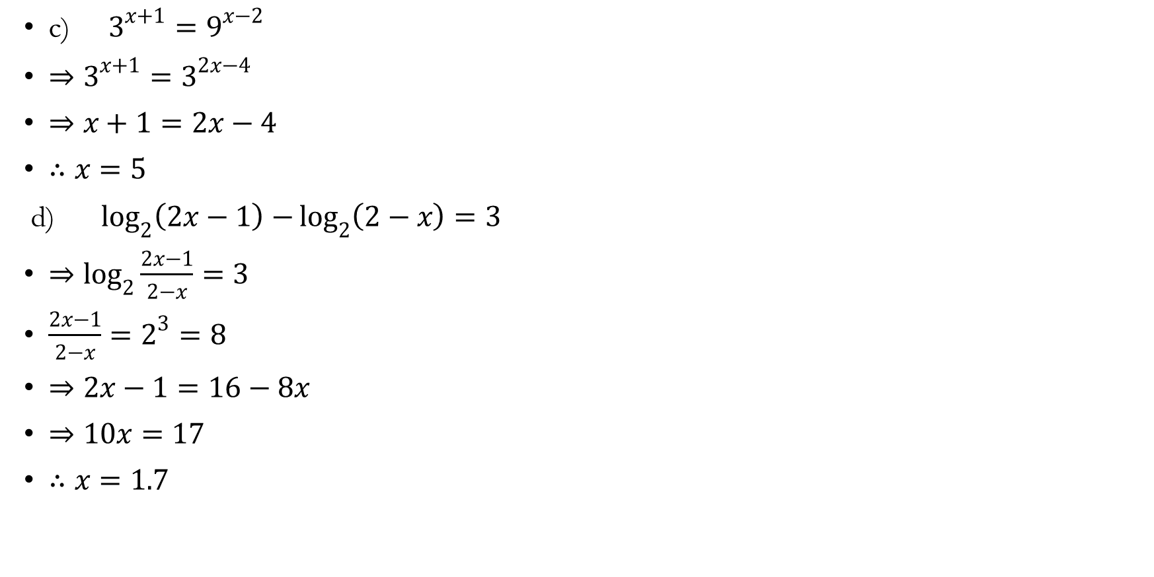
Polynomial (cont’d)

Slide 9
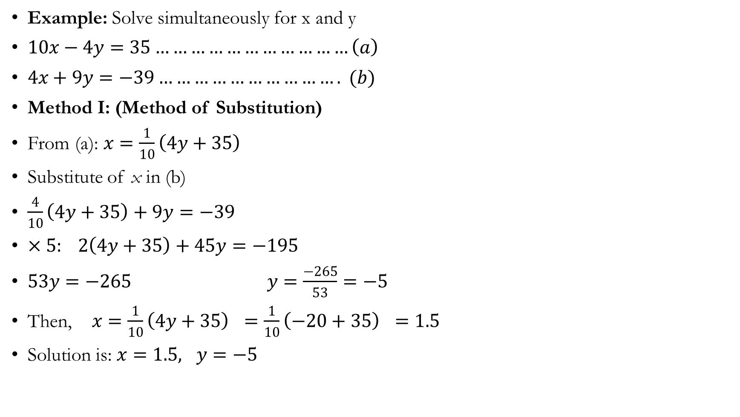
Simultaneous Linear Equations in Two Variables

Slide 10
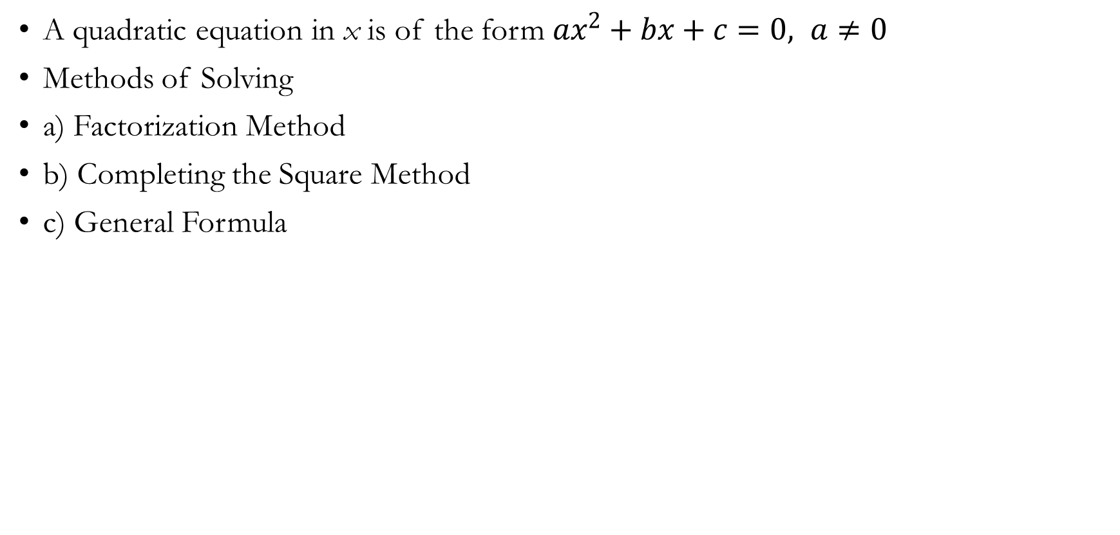
Quadratic Equations

Slide 11
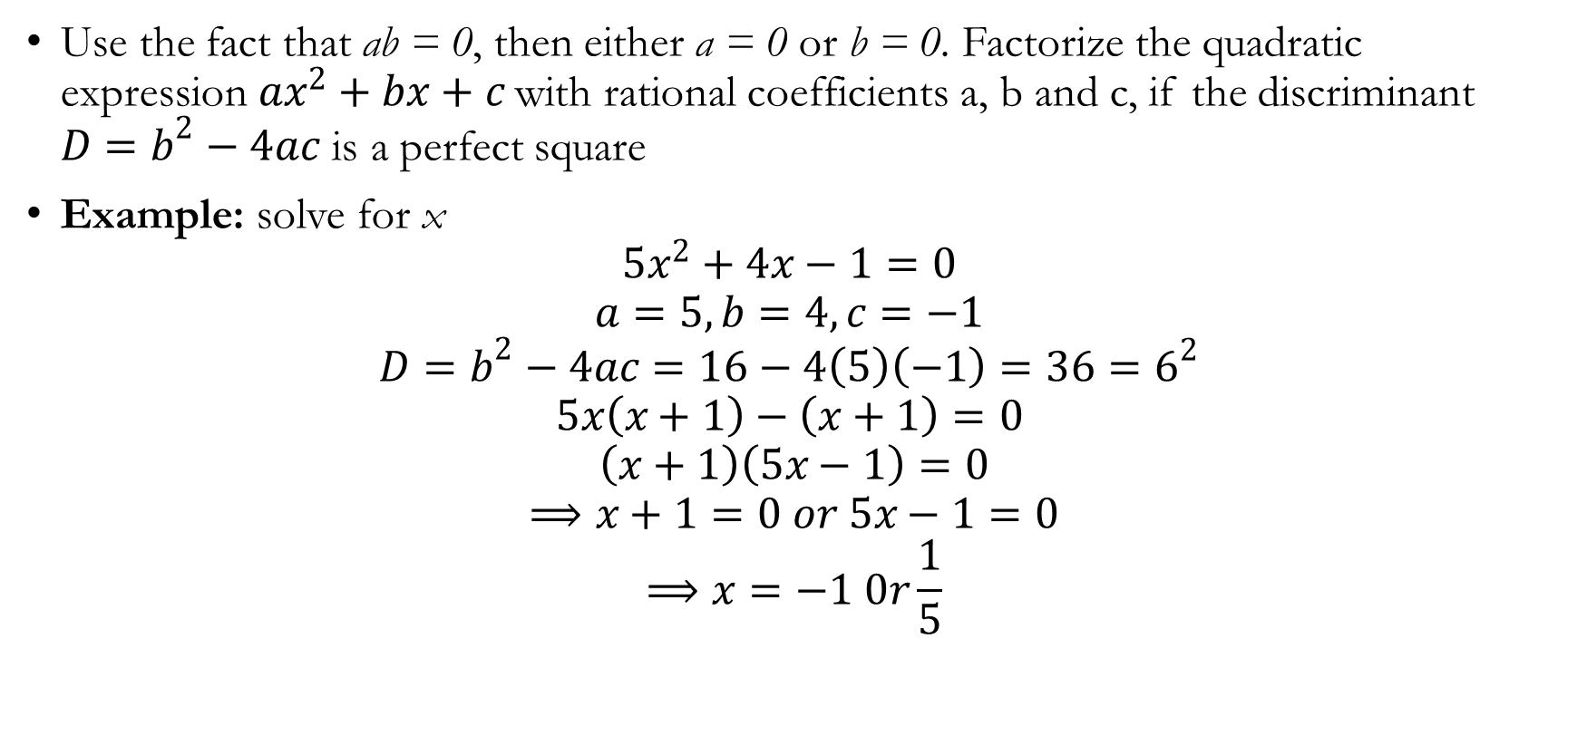
Solution by factorization

Slide 12
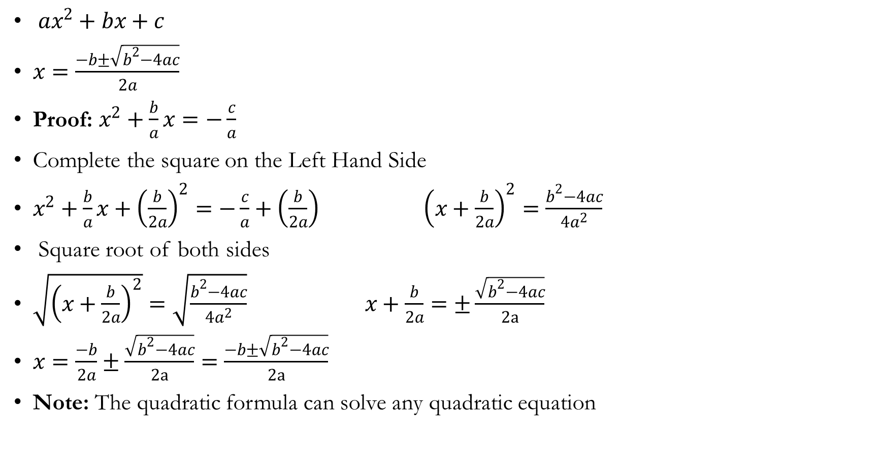
Solution by completing the square quadratic formula.

Slide 13
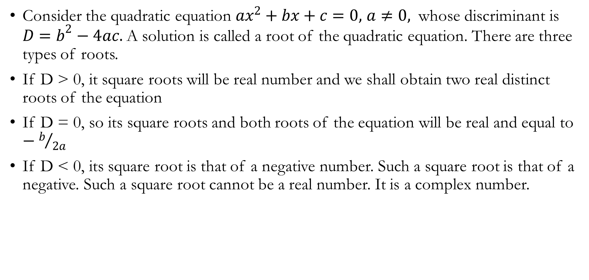
Nature of the roots of a quadratic equation

Slide 14
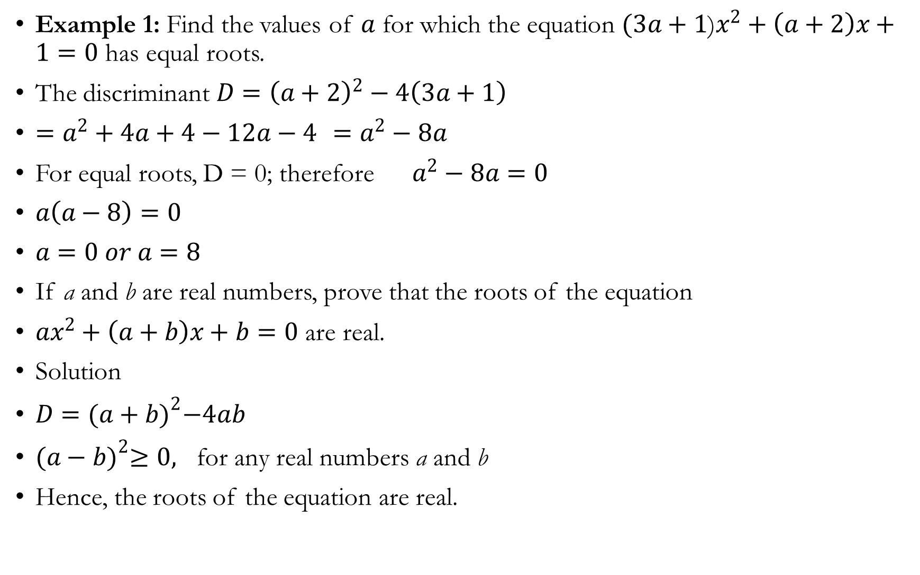

Slide 15
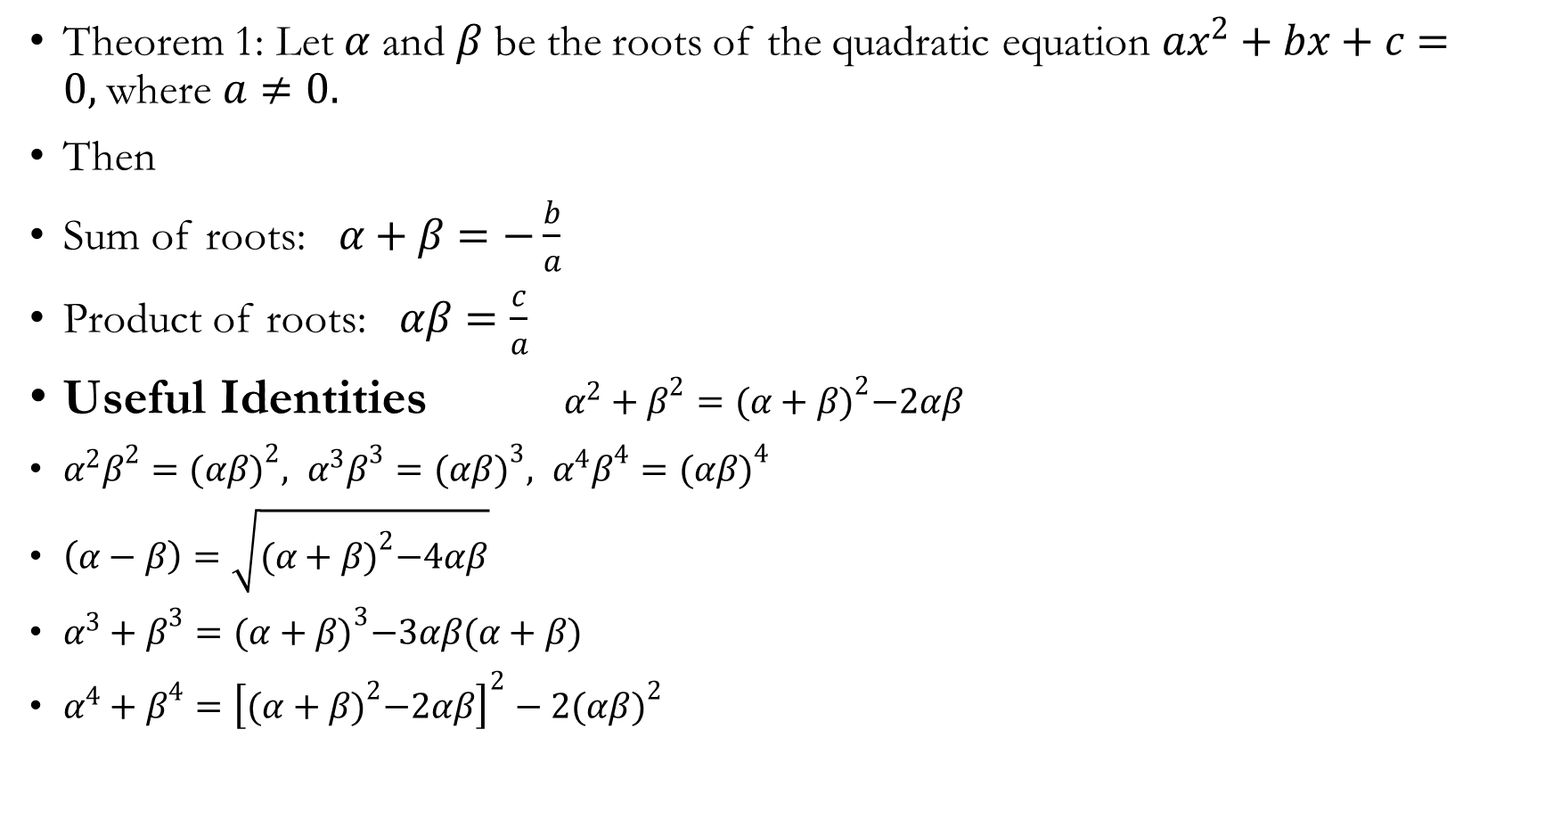
Sum and Product of Roots of a Quadratic Equation

Slide 16
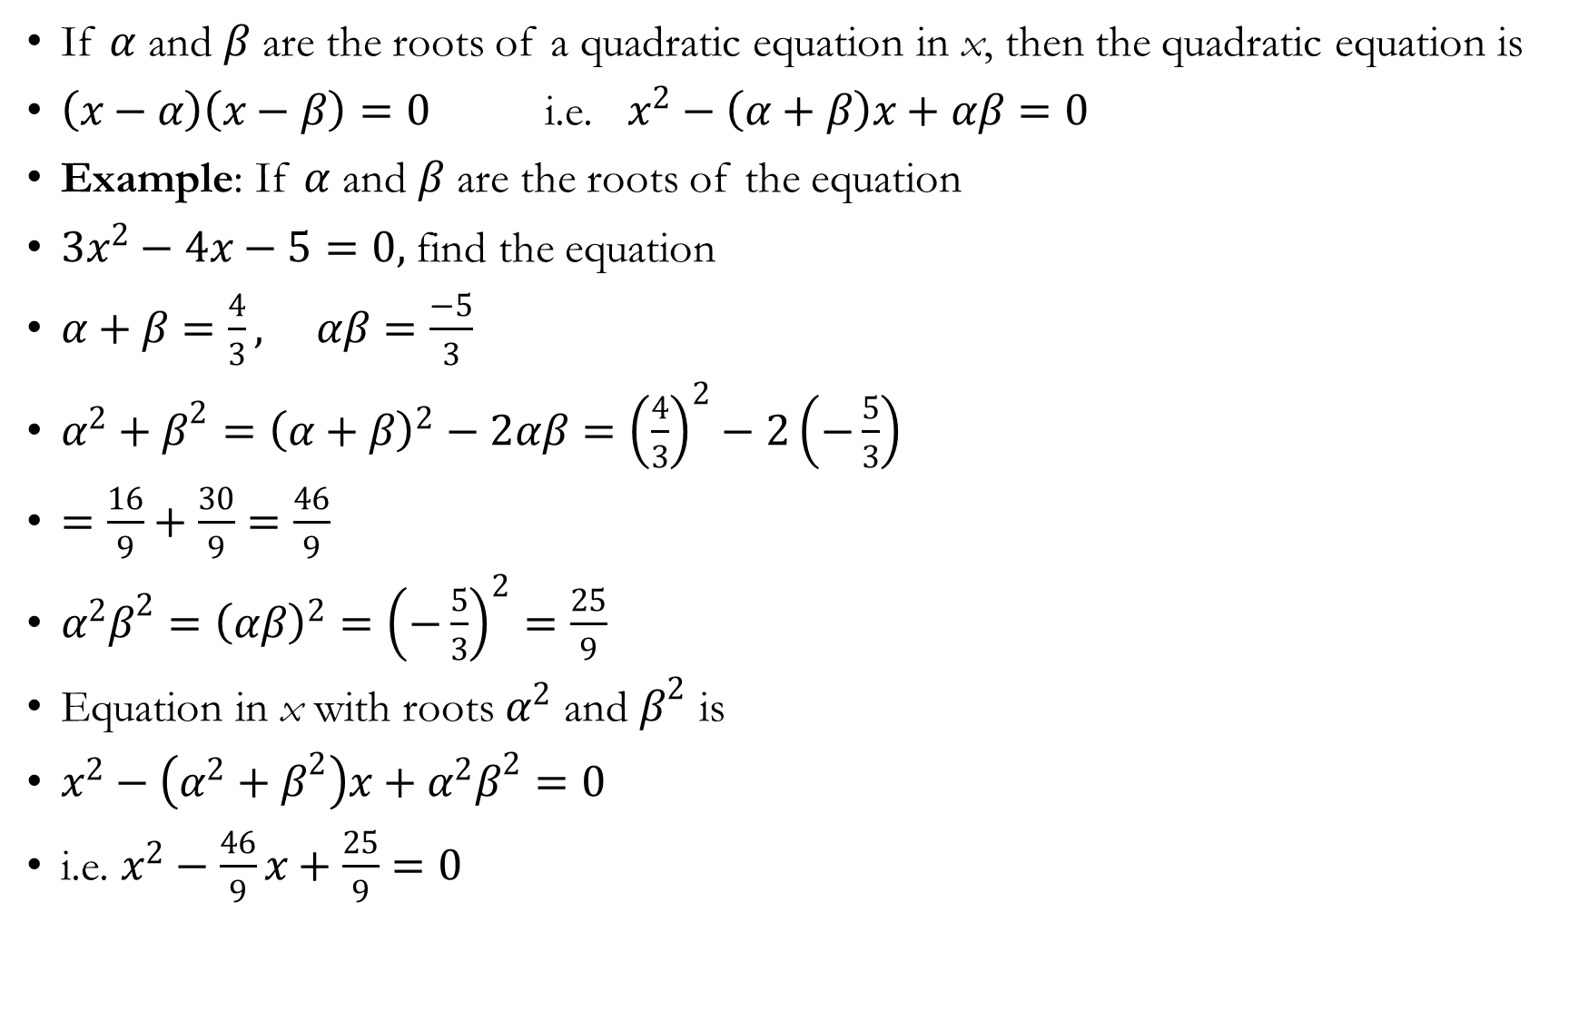

Slide 17
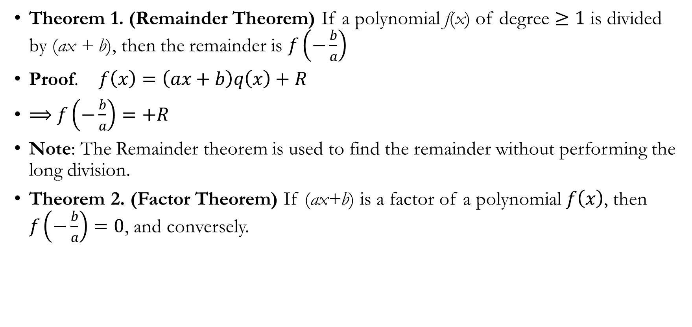
Remainder and Factor Theorems

Slide 18
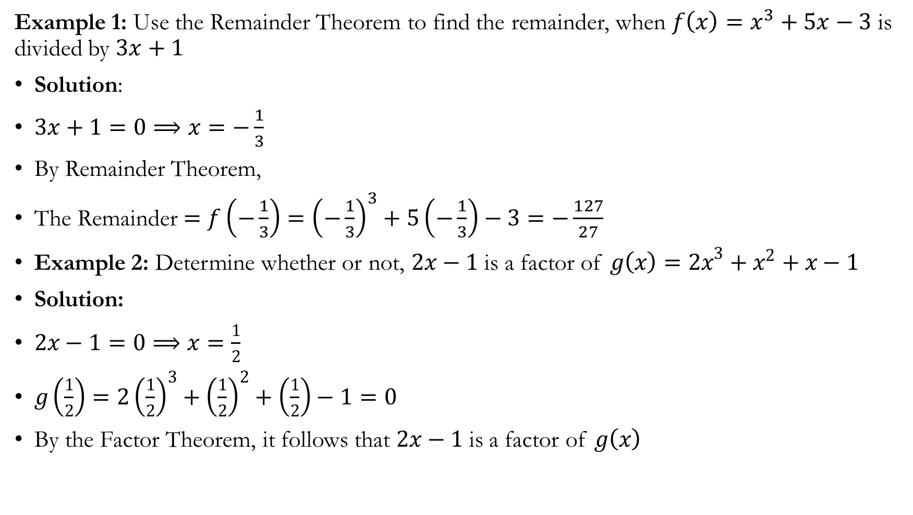

Slide 19
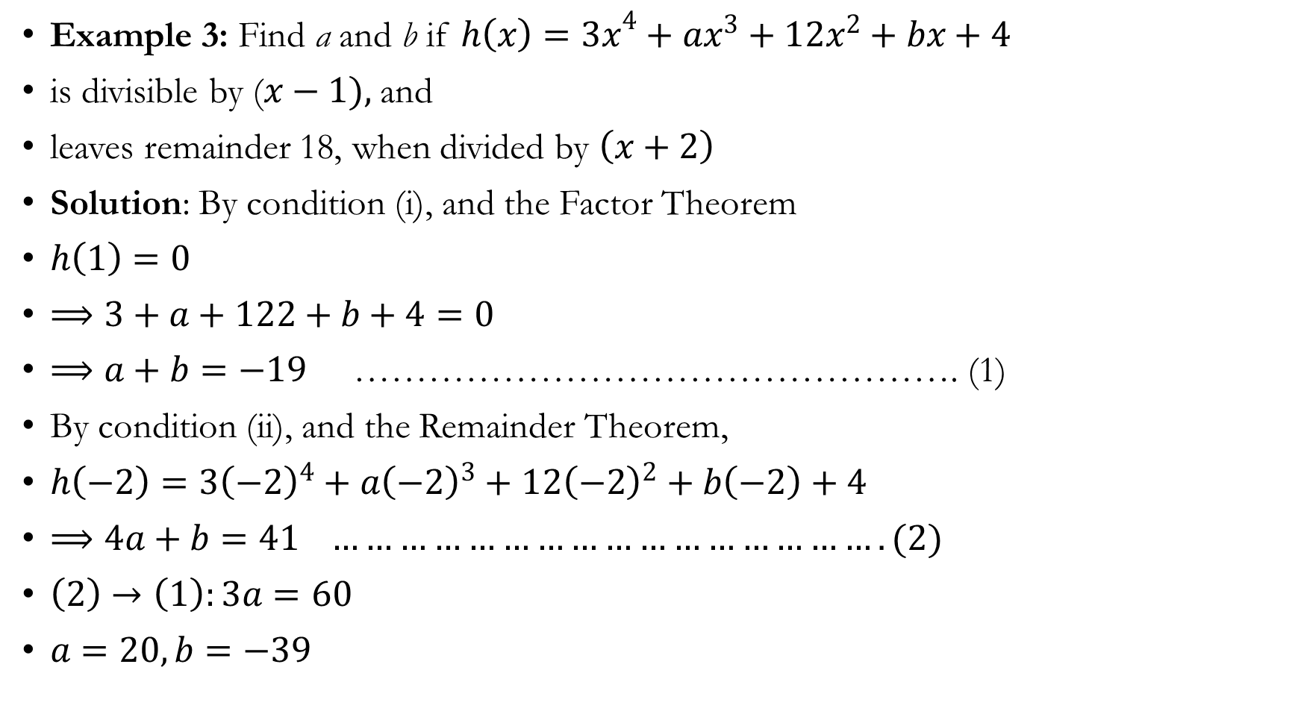

Slide 20
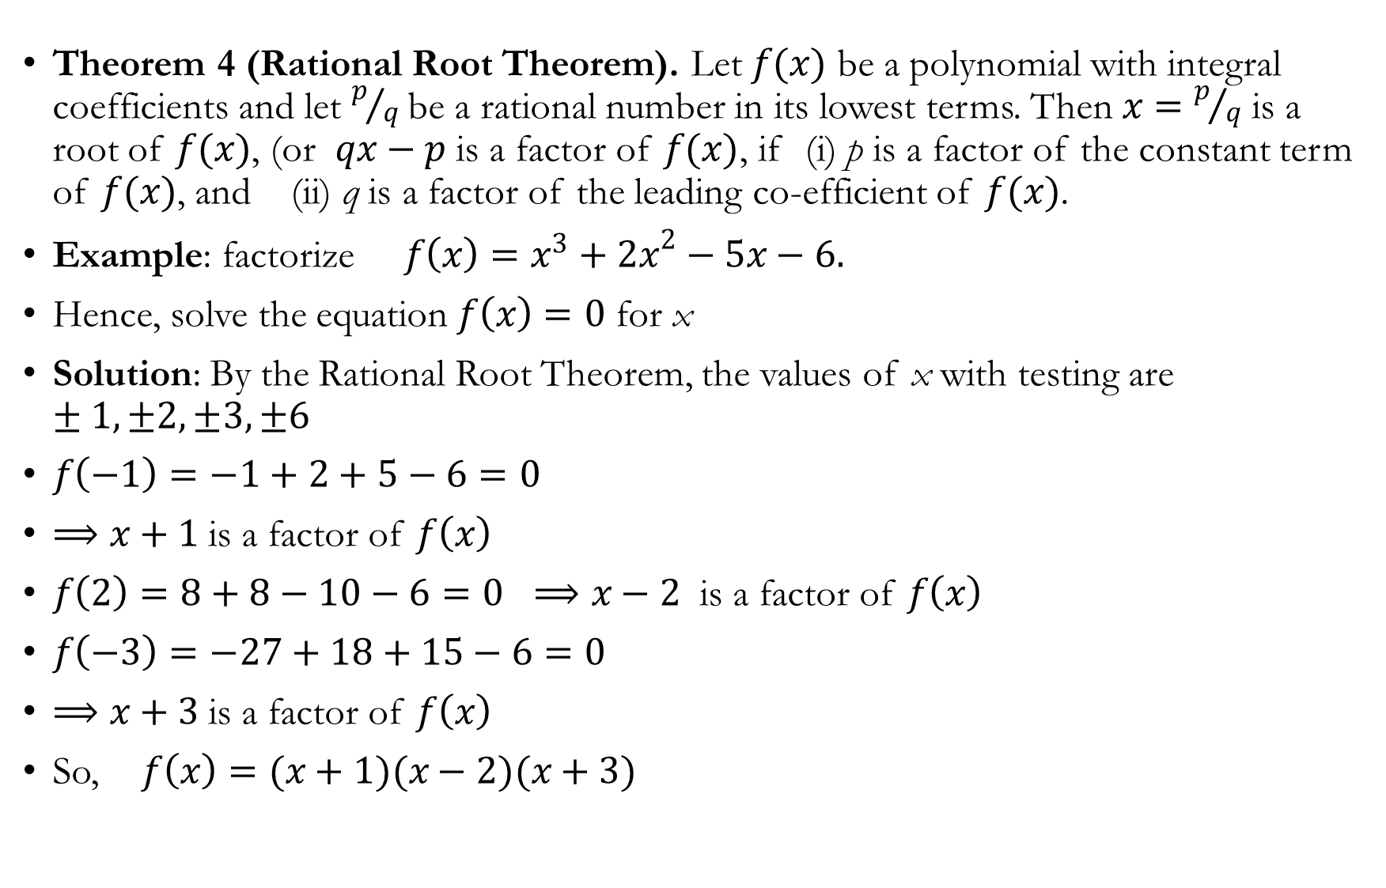

Slide 21
Inequality
Inequalities of numbers can be represented using the interval notation, and geometrically on the real number line
1. | Inequality | Interval | Number line
 |  | Open interval | b a
 |  | Closed interval | b a
 |  | Interval closed on the left and open on the right | b a
 |  | Interval open on the left and closed on the right | b a
 |  |  | b
 |  |  | b
a
b
a
b
a
b
a
b
b
b

Slide 22
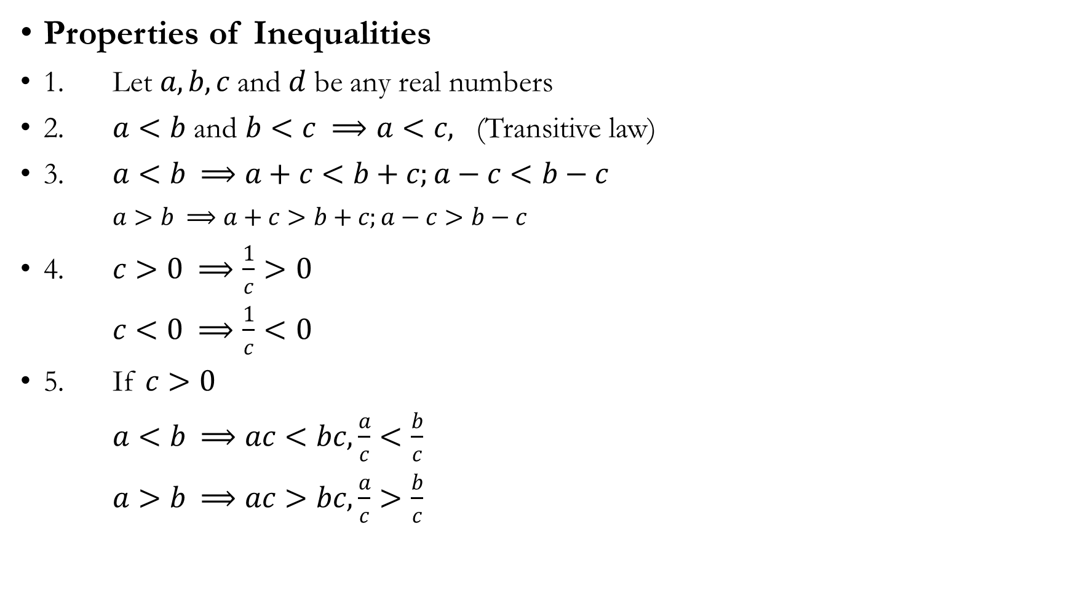

Slide 23
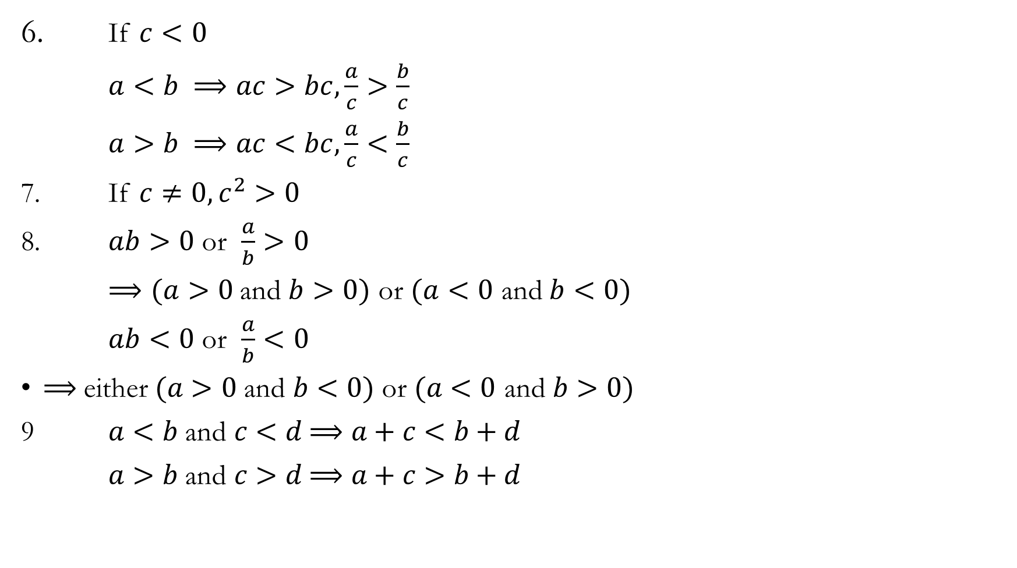

Slide 24
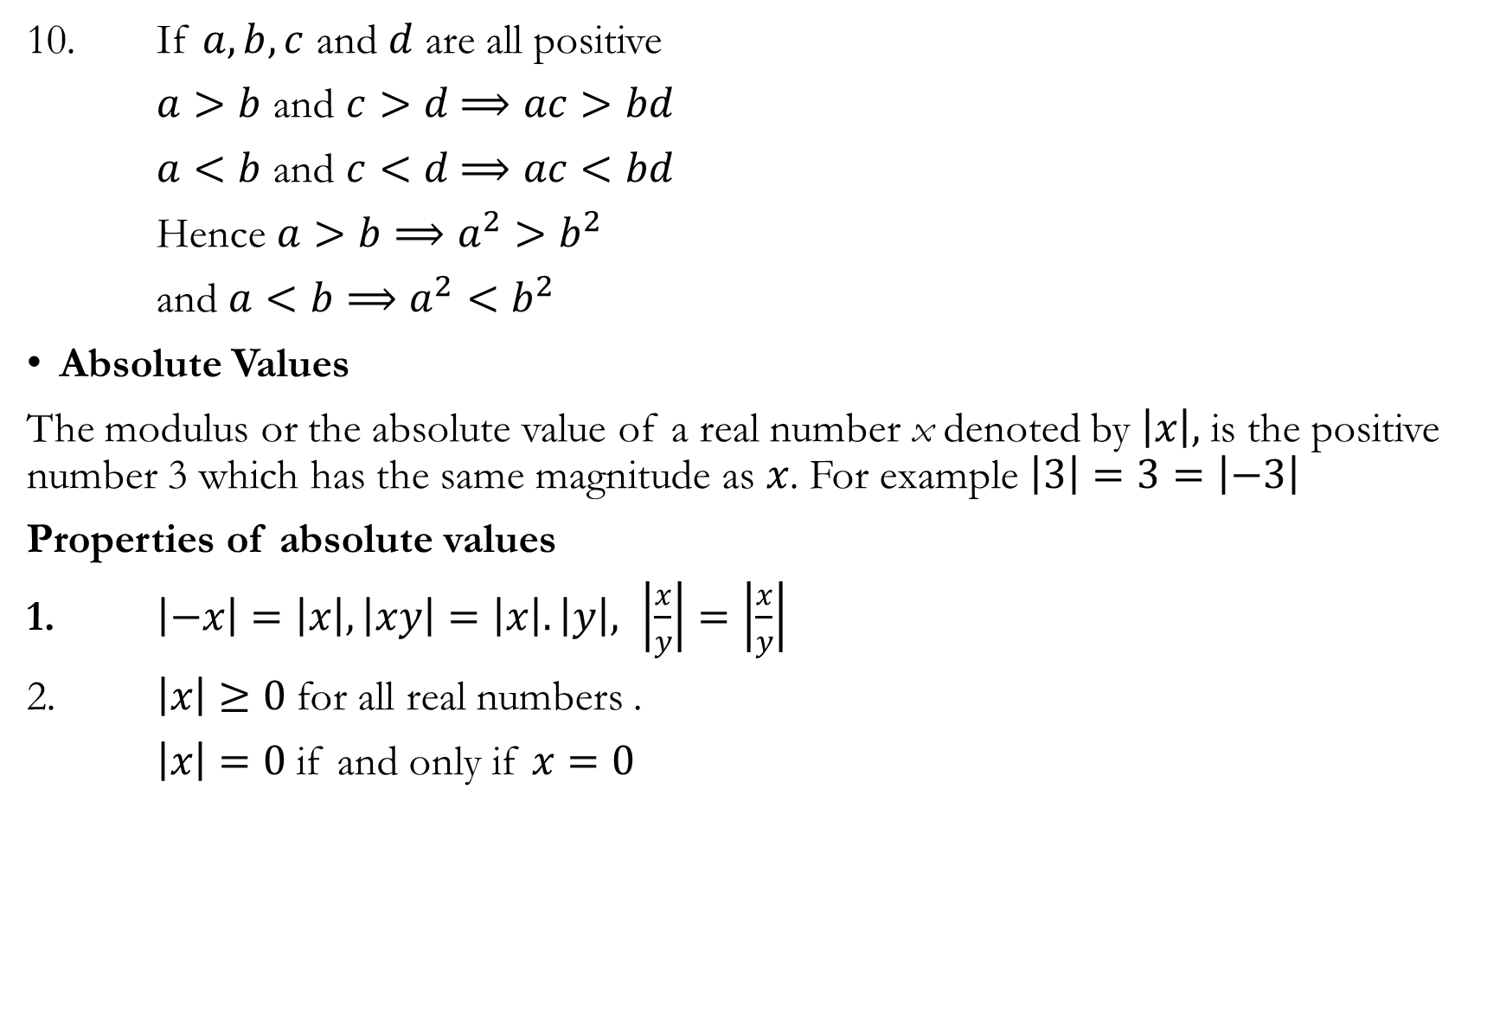

Slide 25
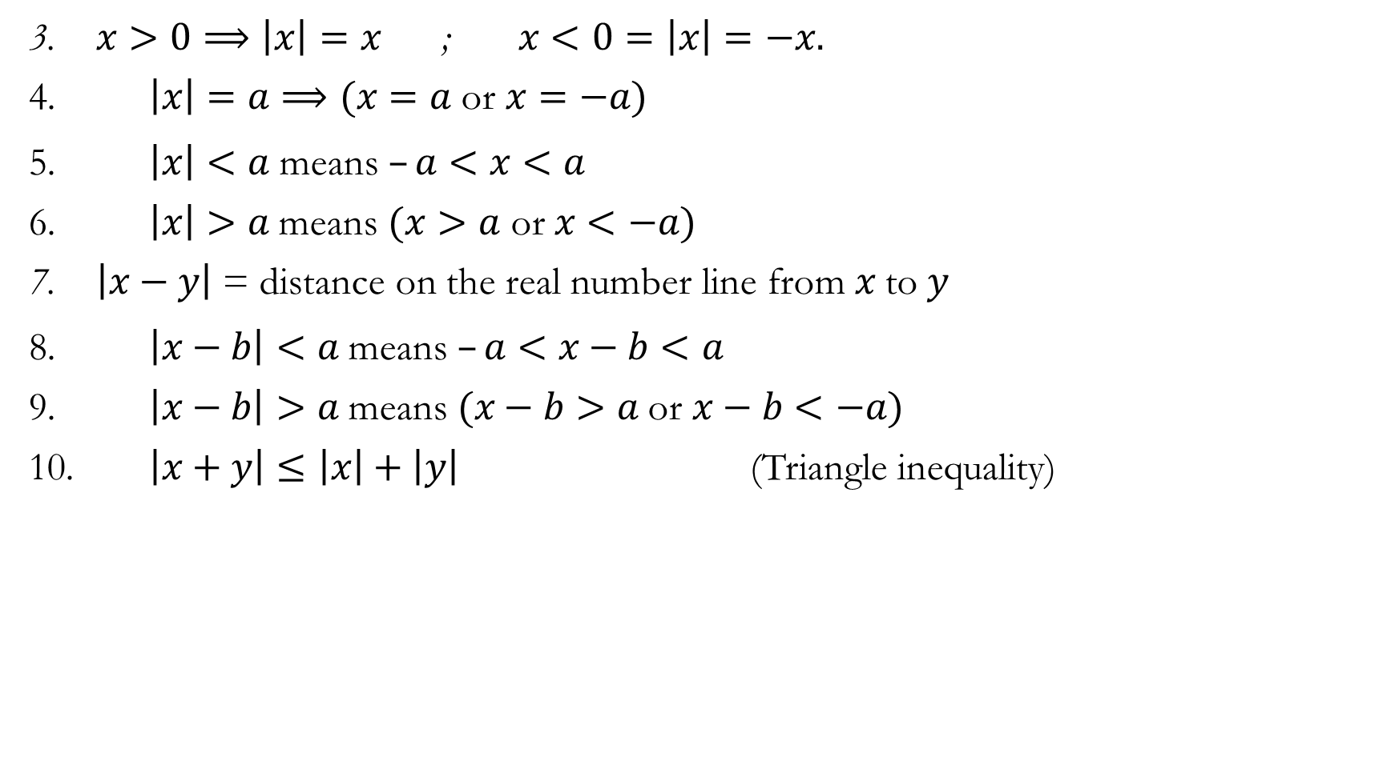

Slide 26
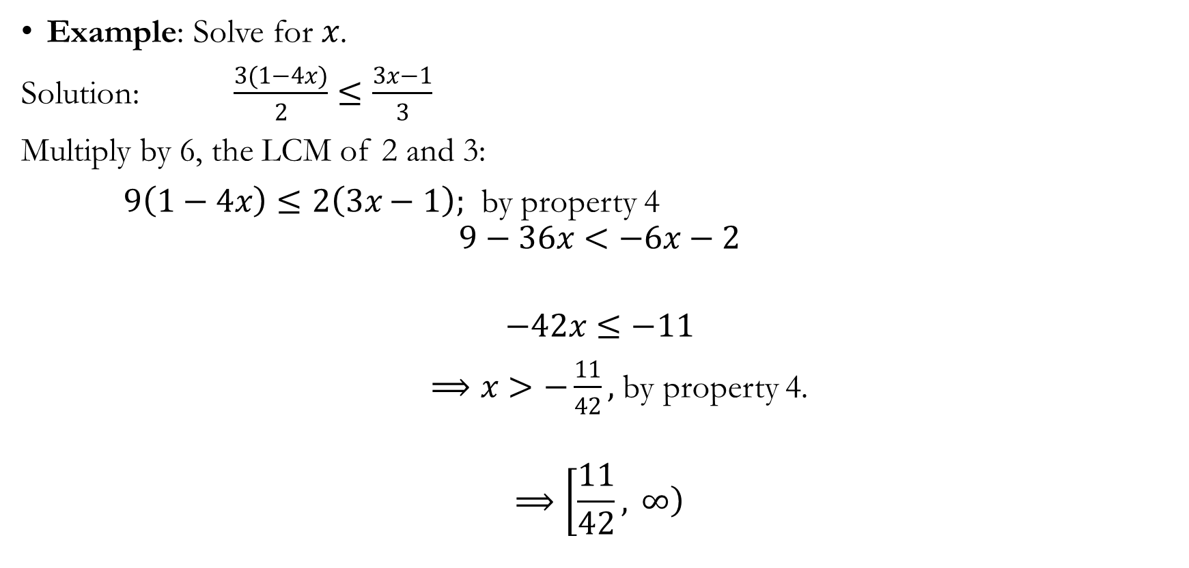
Linear Inequalities

Slide 27
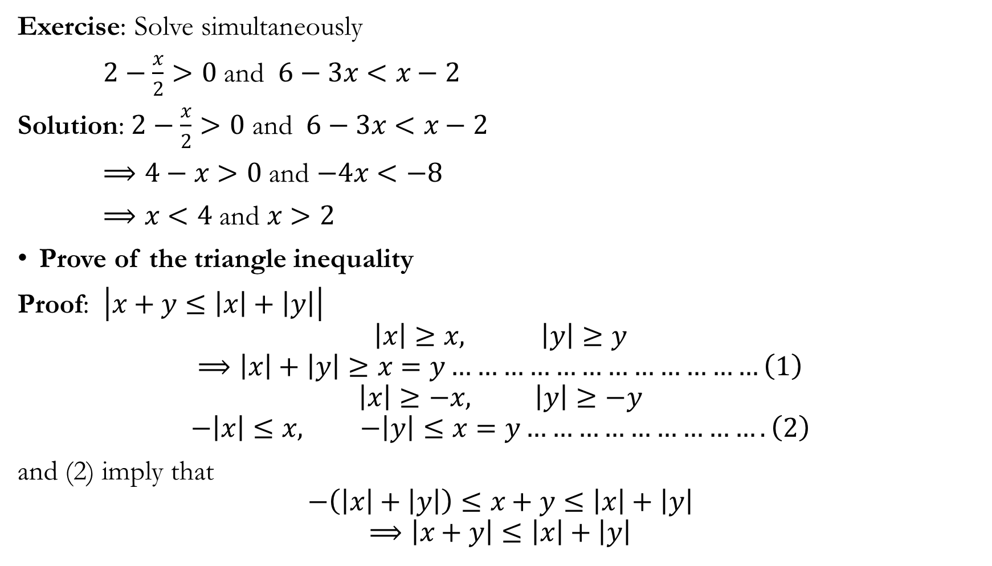

Slide 28
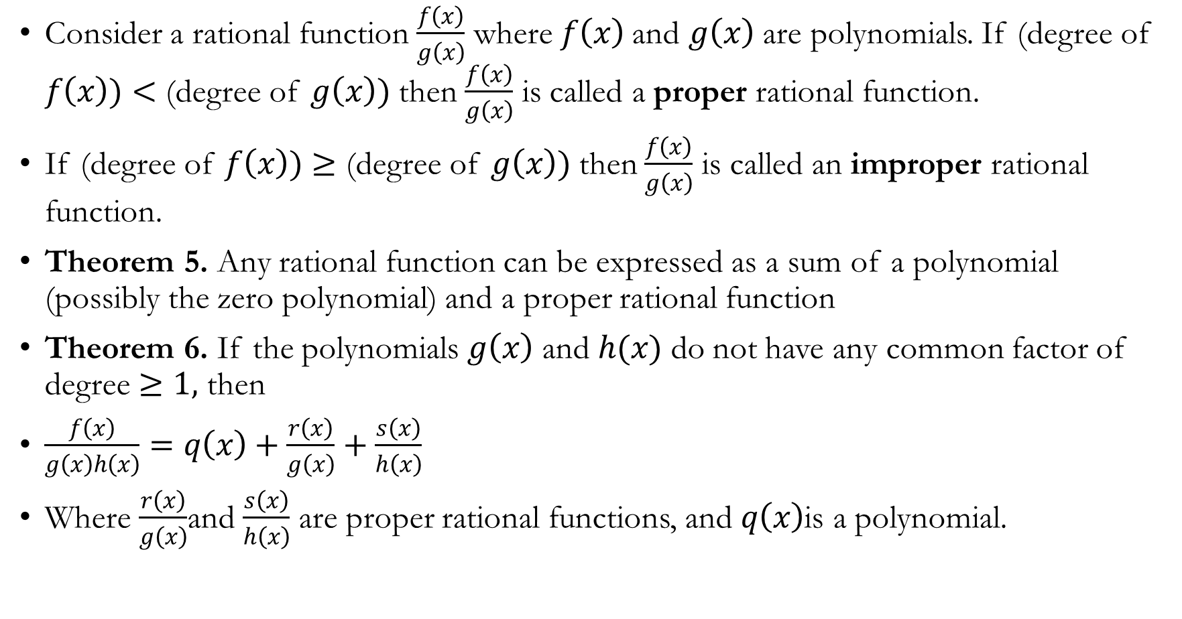
Partial Fractions

Slide 29
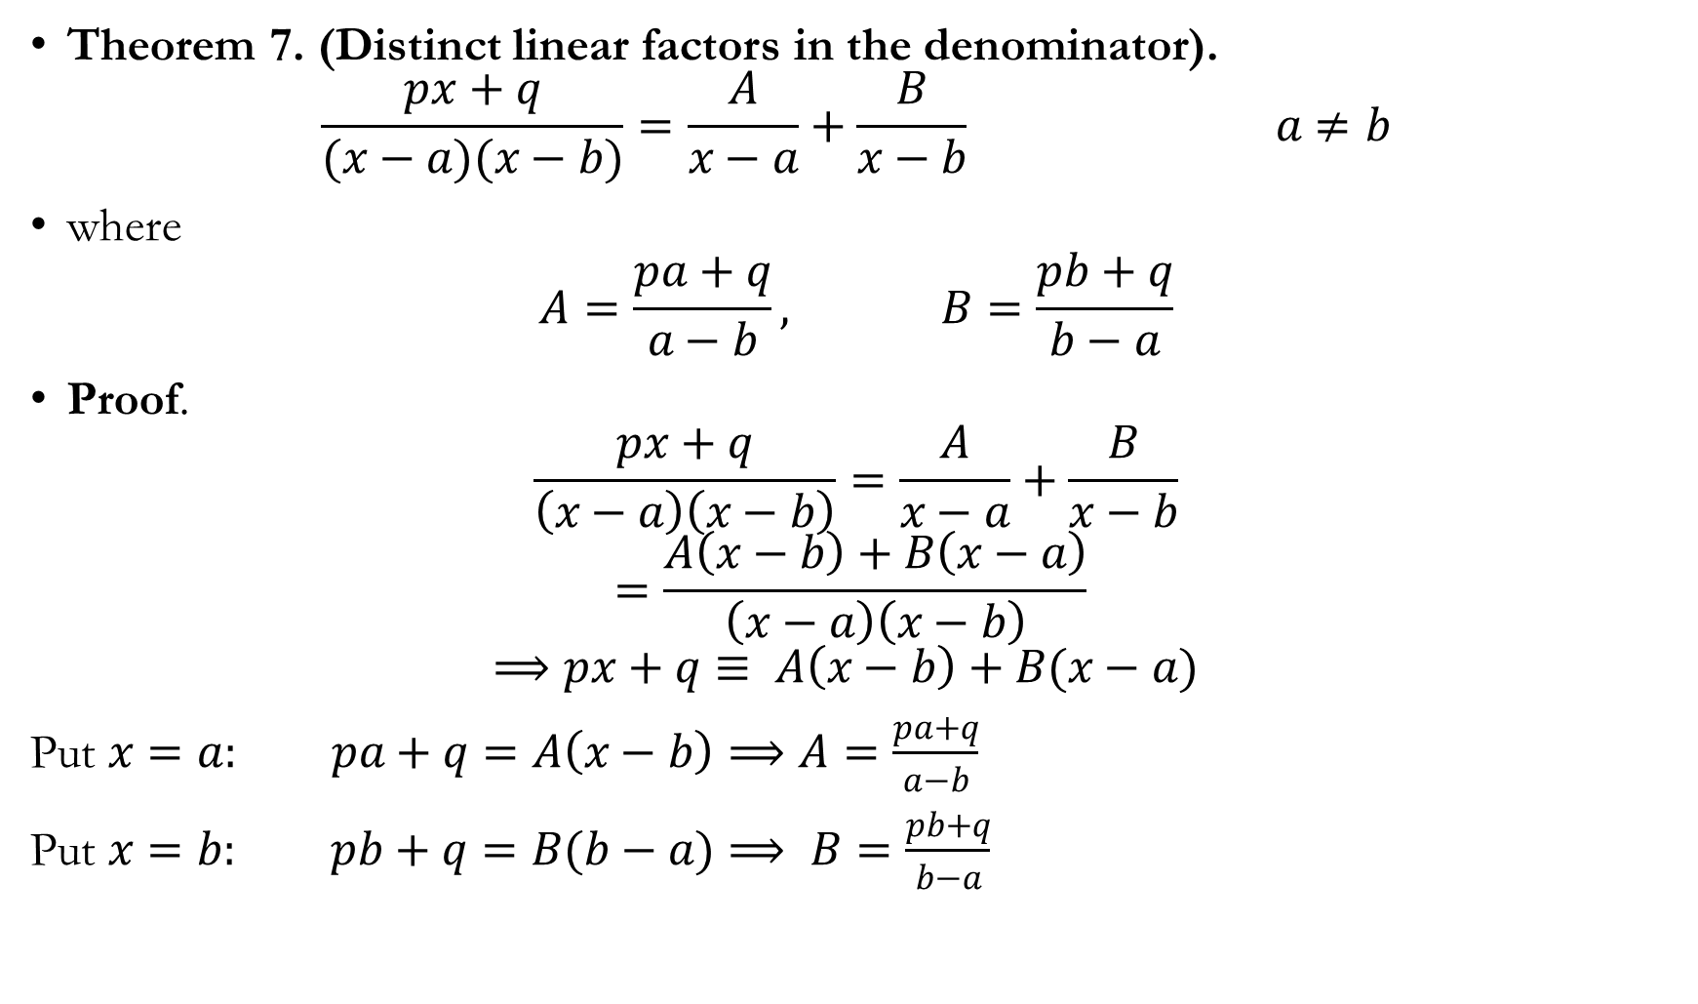

Slide 30
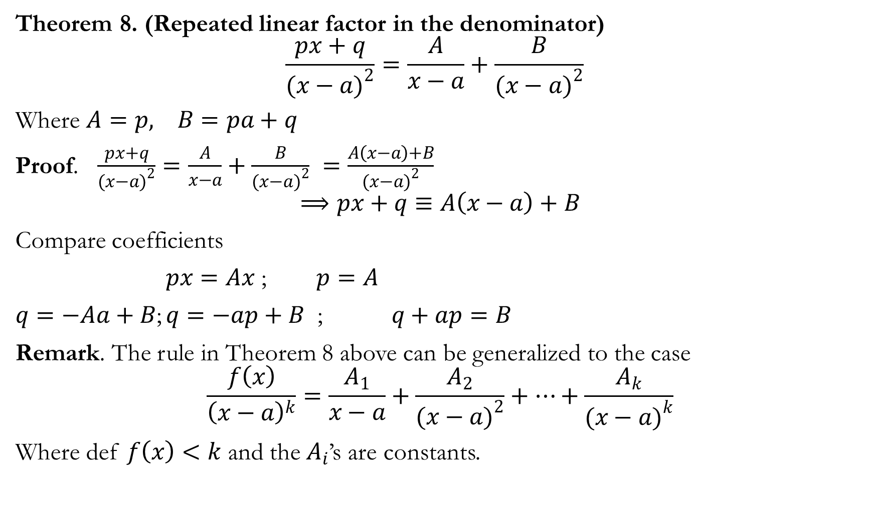

Slide 31
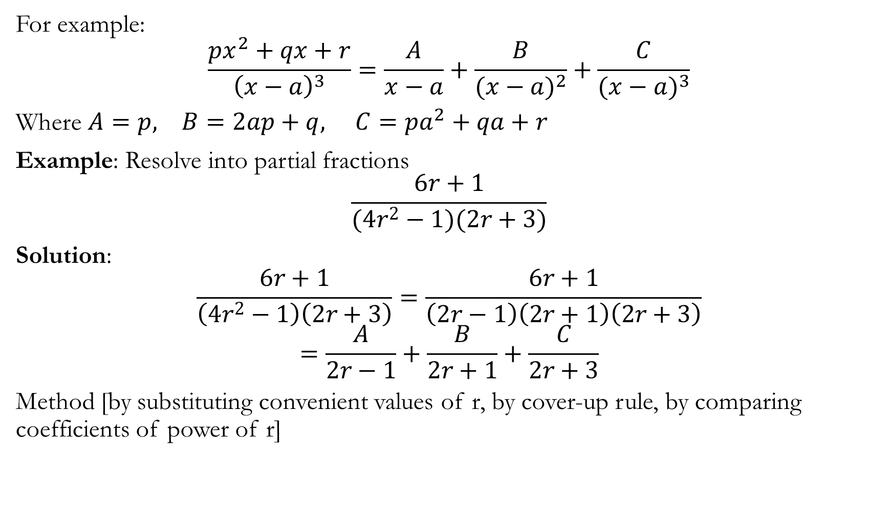

Slide 32
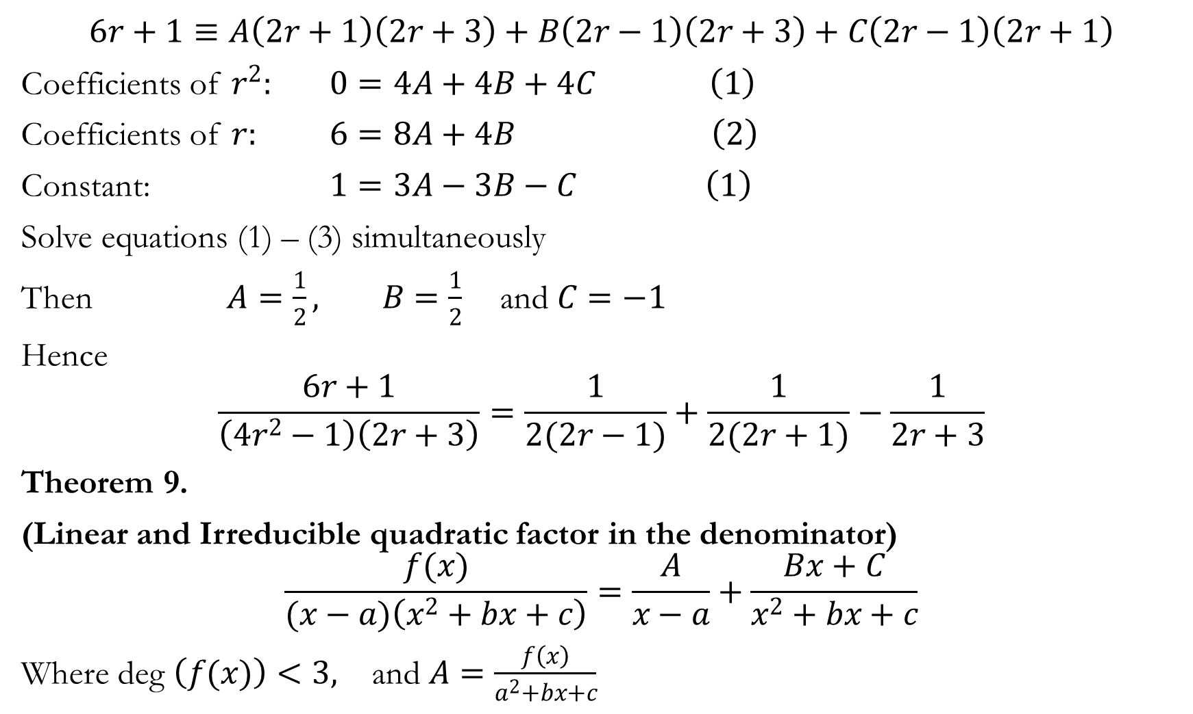

Slide 33
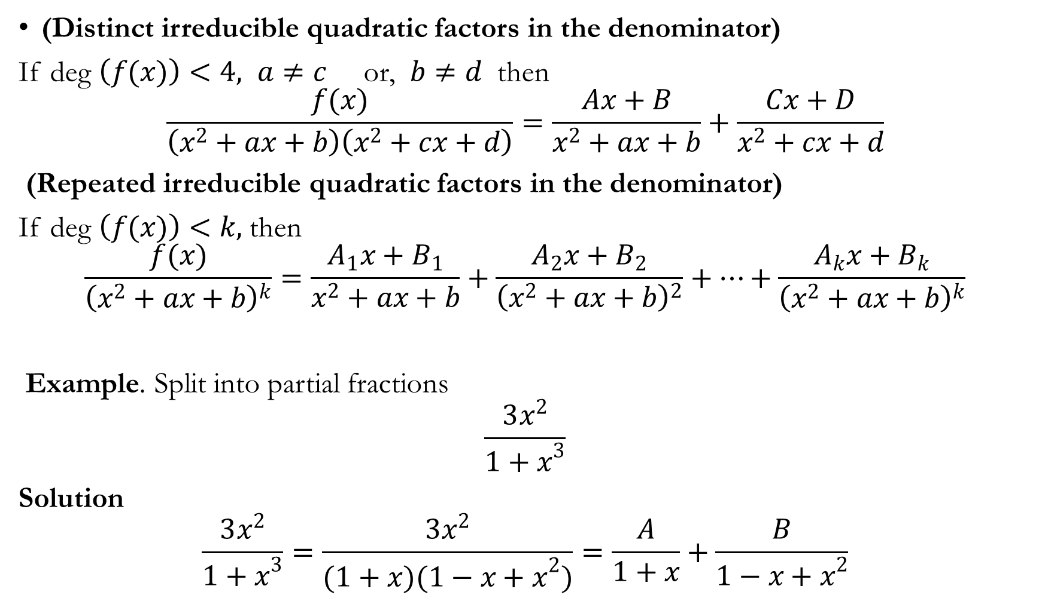

Slide 34
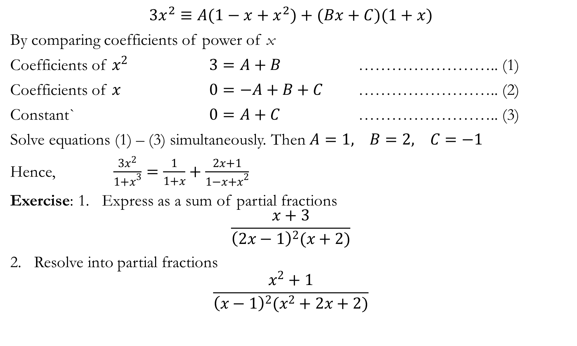

Slide 35
